Slide 1



Kasmo
AGILE METHODOLOGY & SCRUM.

Slide 2
AGENDA
SDLC & MODELS
TRADITIONAL Vs AGILE
01
02
What is SDLC?
Waterfall Model
Drawbacks of Waterfall
Agile Introduction
SCRUM
AGILE MINDSET
04
03
What is being ‘Agile’?
When to use Agile?
Theory, Principles, Values, Teams, Artifacts and Ceremonies.

Slide 3
SDLC is a framework that describes the activities performed at each stage of a software development project.
SDLC process is used by the software industry to design, develop and test high quality software that meets or exceeds customer expectations, reaches completion within time and budget.

Slide 4
PHASES
PLANNING & ANALYSIS
DESIGN
01
Design and Architecture of the project is created.
02
Requirement gathering and analysis. Resolve questions & ambiguities.
Maintenance
IMPLEMENTATION
06
Bug fixes and upgradations to new versions as per need.
Source code creation and implementing the various components.
03
TESTING & INTEGRATION
DEPLOYMENT
05
04
The project is released to the end users after passing the QA.
Testing and Quality Analysis. The components are tested until they meet the requirements.

Slide 5
MODELS
WATERFALL MODEL
Waterfall is the traditional approach to an SDLC. In this model, the whole process is divided into phases. This is a continuous development model which is seen as flowing steadily downwards through various steps of SDLC.
INCREMENTAL MODEL
This is a series of Waterfall cycles. Requirements are divided into groups and are executed as an individual project in Waterfall model.
01
04
SPIRAL MODEL
This is a risk-driven process model. It features an incremental and evolutionary development process which means software is developed over several loops or increments. Each loop may or may not deliver results.
ITERATIVE MODEL
This model focuses on an initial simplified implementation, which the progressively gains more complexity. Iterative development is a way of breaking down development of a large application into smaller pieces.
02
05
V MODEL
V is basically an expansion to Waterfall model where testing and development phases are planned in parallel. One side consists of verification and the other side validation which are joined as a V by coding,
AGILE MODEL
The entire project is divided into small incremental builds. All of these builds are provided in iterations, and each iteration lasts from one to four weeks which are called Sprints.
03
06

Slide 6
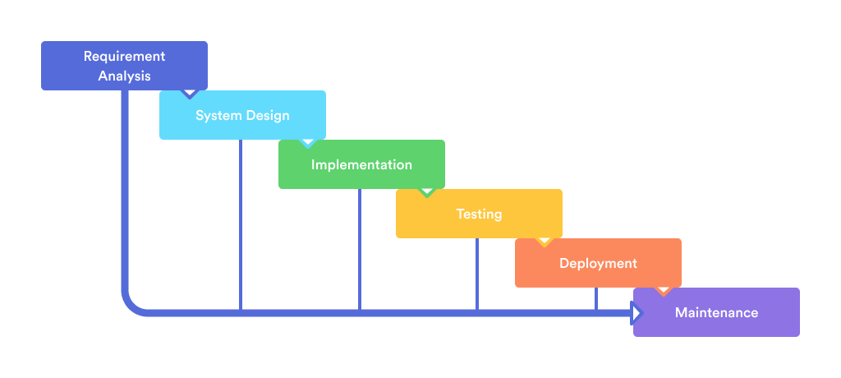
WATERFALL MODEL

Slide 7
WATERFALL MODEL
Oldest And Most Well-known SDLC, Also Called Generally As Traditional Model.
Follows A Sequential Step By Step Process From Requirements Analysis To Maintenance.
Systems That Have Well-defined And Understood Requirements Are A Good Fit For The Waterfall Model.

Slide 8
WATERFALL MODEL
WHEN TO USE?
Requirements Are Very Well Known.
Product Definition Is Stable.
Technology Is Understood.
New Version Of An Existing Software/ Product.
Porting An Existing Product To A New Platform.

Slide 9
WATERFALL MODEL
STRENGTHS
Easy To Understand, Easy To Use.
Provides Structure To Inexperienced Staff.
Milestones Are Well Understood.
Sets Requirements Stability.
Good For Management Control (Plan, Staff, Track).
Works Well When Quality Is More Important Than Cost Of Schedule.

Slide 10
WATERFALL MODEL
WEAKNESSES
All Requirements must be fully specified upfront.
Deliverables created for each phase are considered frozen- inhibits flexibility.
Can give a false impression of progress.
Does not reflect problem solving nature of software development- iterations of phases.
Integration is one big bang at the end.
Little opportunity for customer to preview the system (until it may be too late).

Slide 11
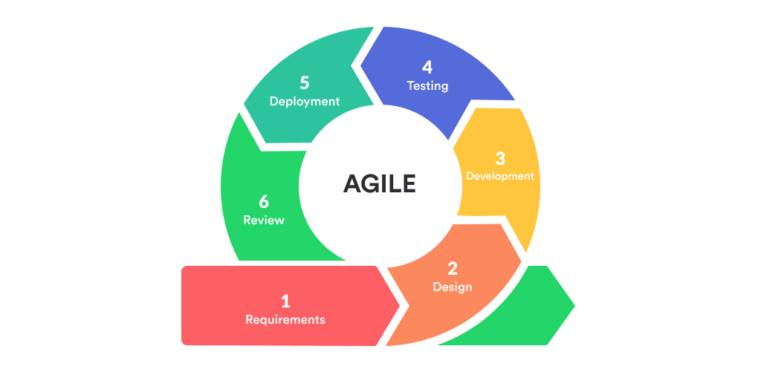
AGILE MODEL

Slide 12
AGILE MODEL
Agile model believes that every project needs to be handled differently and the existing methods need to be tailored to best suit the project requirements.
In agile, the tasks are divided into time boxes (small time frames) to deliver specific features for a release.
Iterative approach is taken and working software build is delivered after each iteration. Each build is incremental in terms of features.
The final build holds all the features required by the customer.

Slide 13
AGILE MINDSET
Agile proponents believe that conventional software development processes are too heavyweight, rigid and cumbersome.
Agile methods are considered lightweight & People based rather than Plan-based.
Being ‘Agile’ is a mindset. It implies the ability to respond to change as soon as it is identified. Agility refers to responding to changes and adapting to new scenarios within no time.

Slide 14
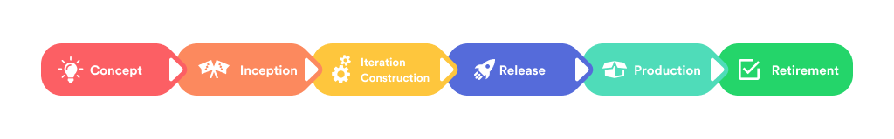
AGILE WORKFLOW
Agile SDLC Consists Of Various Steps. The Main Purpose Of Each Step Is To Bring The Team Closer To The Final Result As Soon As Possible And To Release New Software Just As Quickly.

Slide 15
WHEN TO USE AGILE?
When you have limited resources with complex deliveries ahead of you.
You can use agile for projects that aren’t well-defined
Those projects that come with a short deadline
Working with projects that are hard to estimate
If the process is too rigid for your current situation
You developing a complex product from scratch without a clearly defined end vision.

Slide 16
AGILE FRAMEWORKS
SCRUM
Kanban
Lean Software Development
Extreme Programming (XP)
Crystal Development Framework
Dynamic System Development
Feature Driven Development (FDD)

Slide 17
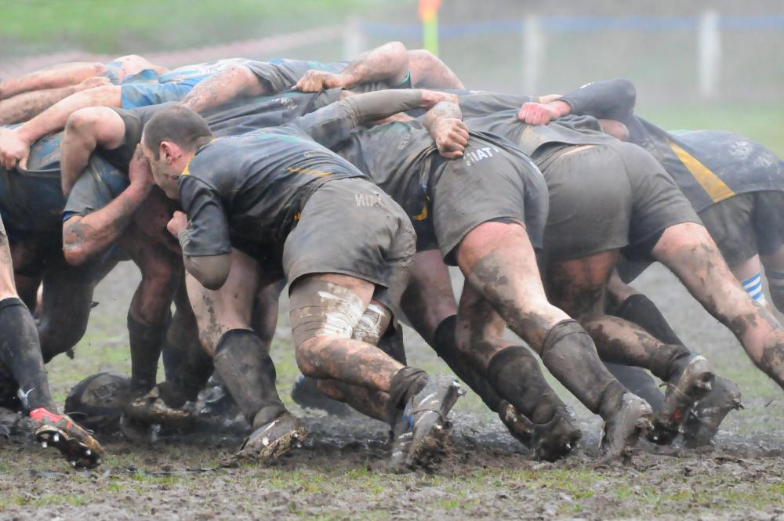

Slide 18
SCRUM
SCRUM is a dominant approach to Agile Methodology. Scrum is very popular and is in wide use today.
Scrum is a lightweight framework for project management, with an initial emphasis on software development, although it has been in other fields including research, sales, marketing etc.
It is a FRAMEWORK of Rules, Roles and Principles. It helps people and organizations discover what works best for them.

Slide 19
SCRUM
Scrum usually deals with the fact that the requirements are likely to change or most of the time not known at the start of the project.
By definition, scrum is a lightweight framework that helps people, teams and organizations generate value through adaptive solutions for complex problems.
The scrum framework is purposefully incomplete, only defining the parts required to implement Scrum theory.

Slide 20
SCRUM THEORY
Scrum is founded on Empiricism and Lean Thinking.
Empiricism asserts that knowledge comes from experience and making decisions based on what is observed.
Lean Thinking reduces waste and focuses on the essentials.
Scrum employs an iterative, incremental approach to optimize predictability and control risk.

Slide 21
PILLARS OF SCRUM
Scrum has four formal events within a containing event called the Sprint.
These events work because they implement empirical process control through 3 pillars called Transparency, Inspection and Adaptation.

Slide 22
TRANSPARENCY
Scrum is an emergent process. It demands that work must be visible to those performing it as well as those receiving it.
Important decisions are made based on what can be seen and inspected through out the iterative process.
Transparency enables Inspection. Inspection without transparency is misleading and wasteful.

Slide 23
INSPECTION
Progress towards the agreed goals must be inspected frequently and diligently to detect potentially undesirable variances.
To help with inspection, Scrum provides cadence in the form of its five events.
Inspection enables adaptation. Inspection without adaptation is considered pointless. After all, Scrum events are designed to provoke change.

Slide 24
ADAPTATION
If any aspects of the iterative process deviate outside acceptable limits, the process being applied or the products being produced must be adjusted.
The adjustment must be made as soon as possible to minimize further deviation.
A scrum team is expected to adapt the moment it learns anything new through inspection.

Slide 25
SCRUM VALUES
Successful use of Scrum depends on people becoming more proficient in living five rules:
COMMITMENT, FOCUS, OPENNESS, RESPECT AND COURAGE.
The values give direction to the Scrum Team with regard to their work, actions and behaviour.

Slide 26
SCRUM TEAM
The Scrum Team consists of a Scrum Master, a Product Owner and Developers.
This team is cross-functional- members have all the skills necessary to create value each Sprint.
They are also self-managing meaning they internally decide who does what, when and how.
Smaller teams communicate better and are more productive. Hence the size of a team is typically 10 or fewer.

Slide 27
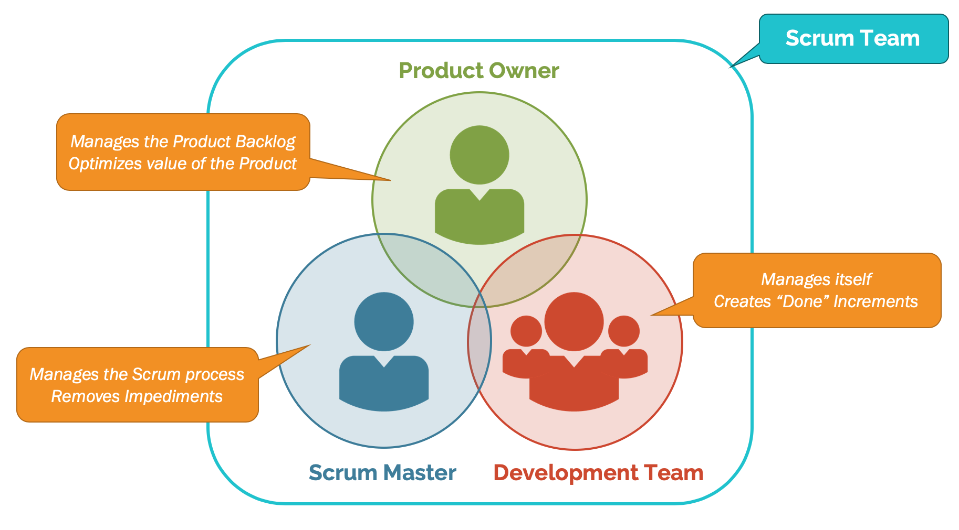
SCRUM TEAM

Slide 28
PRODUCT OWNER
Accountable for maximizing the value of the product resulting from the work of the Scrum Team.
Product Owner is responsible for developing and communicating the Product Goal.
Creating and prioritizing requirements also known as Product Backlog Items.
Ensuring the Product Backlog is transparent, visible and understood.
Represents the stakeholders in the development process.

Slide 29
SCRUM MASTER
Scrum Master is accountable for establishing Scrum.
Is accountable for Scrum Team’s effectiveness and diligent practice of agile principles.
They serve the Scrum team by facilitating various scrum events. Coaches teams in achieving cross-functionality and self-management.
Remove impediments. Ensure that all Scrum events take place within the timebox and are productive and positive.
They serve the PO by facilitating Stakeholder collaboration as needed.
They serve the organization by leading, training and coaching in its Scrum adoption.

Slide 30
DEVELOPERS
Developers are the people in the Scrum Team that are committed to creating usable Increment each Sprint.
The developers are accountable for creating a plan for the Sprint and ordering the Sprint Backlog.
Adapting their plan each day towards the Sprint Goal and holding each other accountable as professionals.

Slide 31
SCRUM ARTIFACTS
Scrum’s artifacts represent Work or Value. They are designed to maximize transparency thus everyone inspecting them has the same basis for adaptation.
The Product Backlog, Sprint Backlog and the Increment are the three artifacts of Scrum.
Each artifact contains a commitment.

Slide 32
PRODUCT BACKLOG
The Product Backlog is an emergent, ordered list of what is needed to improve the product.
It is the single source of work undertaken by the Scrum Team.
The Product Backlog is committed to the Product Goal.
Product Goal describes a future state of the product which can serve as a target for the Scrum Team to plan against.

Slide 33
SPRINT BACKLOG
The Sprint Backlog is a plan by and for the Developers.
It is a highly visible, real time picture of the work that the Developers plan to accomplish during the Sprint.
The Sprint Backlog is committed to the Sprint Goal.
The Sprint Goal is the single objective for the Sprint. It is created during the Sprint Planning.

Slide 34
INCREMENT
An Increment is a concrete stepping stone towards the Product Goal.
Each Increment is additive to the prior Increments and thoroughly verified, ensuring that they all work together.
The Increment is committed to achieving the Definition of Done.
DoD is a formal description of the state of the Increment when it meets the quality measures required for the product.
The moment a Product Backlog item meets the DoD, an Increment is born.

Slide 35
THE SPRINT
The Sprint is the fundamental unit of Scrum where ideas are turned into value.
They are of fixed length: 4 weeks or less to create consistency.
All the work necessary to achieve the Product Goal are conducted within the Sprint.
Sprint enables predictability by ensuring inspection and adaptation.
A Sprint could be cancelled if the Sprint Goal becomes obsolete.

Slide 36
SPRINT PLANNING
Sprint Planning initiates the Sprint by laying out the work to be performed for the Sprint.
Attended by Product Owner, Scrum Master and Developers.
The Product Owners puts forward a prioritized Product Backlog for the Developers to discuss from.
The Sprint Planning results in the Sprint Backlog and the Sprint Goal.
Planning is Timeboxed at 8 hours for a 4 week Sprint and less for shorter Sprints.

Slide 37
INCREMENT
An Increment is a concrete stepping stone towards the Product Goal.
Each Increment is additive to the prior Increments and thoroughly verified, ensuring that they all work together.
The Increment is committed to achieving the Definition of Done.
DoD is a formal description of the state of the Increment when it meets the quality measures required for the product.
The moment a Product Backlog item meets the DoD, an Increment is born.

Slide 38
DAILY SCRUM
Daily Scrum is a 15-minute event for the Developers of the Scrum Team.
It is held at the same time and place every day to reduce complexity.
The purpose of the Daily Scrum is to inspect progress towards the Sprint Goal and adapt as necessary.
The Scrum Master focuses on finding and resolving impediments.

Slide 39
SPRINT REVIEW
Sprint Review is conducted to give the stakeholders a demo of the work finished during the Sprint.
It ensures a chance to inspect the outcome of the Sprint and determine future adaptations.
Based on the intellect or the feedback gathered during this event, the Scrum Team collaborates on what to do next.
Sprint Review is timeboxed to a maximum of 4 hours for 1 month Sprints and lesser for shorter Sprints.

Slide 40
RETROSPECTIVE
Sprint Retrospective is the last event and is conducted on the last day of the Sprint.
The purpose of the Retrospective is to plan ways to increase quality and effectiveness.
Scrum Team inspects how the previous Sprint with respect to individuals, interactions, processes, tools and their Definition of Done.
3 major questions are posed during Retrospective: What went well, What did not go well and What should we Start/Stop/Continue doing?
It is timeboxed at a maximum of 3 hours.

